Slide 1
Interconnections
Geographies of Interconnections
Year 9

Slide 2
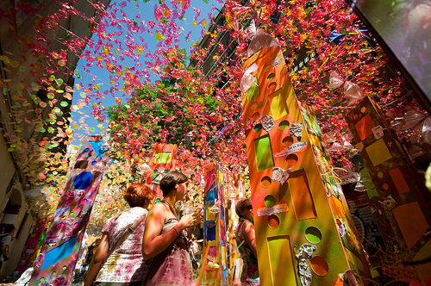
Notes:
Festival in Barcelona, Spain

Slide 3
Pre-quiz
1 List all of the significant places you have lived or visited.
2 Annotate or colour-code your list to show which places you have positive memories of and which places you didn’t like.
3 Name a place that you can imagine clearly, but that you have never visited. Describe how you imagine it to be, using the five senses.

Slide 4
Pre-quiz
4. For the place you named in question 3, explain how you have formed a sense of what it is like, without having been there.
5. Explain why two people might have different feelings about the same place.
6. Using at least two examples, describe how the world is becoming more interconnected.

Slide 5
Glossary
interconnectedness—being interconnected or linked to other people or places culturally, economically or socially
perception—the identification and interpretation of sensory information in order to represent and understand the environment
place—specific areas of the earth’s surface that have been given meanings, or which have been shaped by people
place identity—the linking of aspects of identity with place

Slide 6
What does it mean?
We are all products of our surroundings.
What shapes us as individuals?
The location where we live (town, farm, apartment, nation)
The immediate local environment (wheatbelt – meagacity)
Personal Geography – the way in which we view and make sense of the world around us. Personal Geography grows as we become older due to experiences and exploring what life offers.
Young adults routinely leave move away from their home and return when older.

Slide 7
Place Perception
Write these questions in your notes and answer in your own words:
What does Place Perception mean?
How do we arrive at our perceptions of place?
Place Perception: refers to our awareness of places and opinions we have of locations/places.
Perception of the same place differs from person to person.
Feelings and interpretations influence decisions and opinions of place. Personal meaning and significance ie. a special memory of a family holiday.

Slide 8
Filters
Filters: Personal and Group characteristics:
Race
Gender
Nationality
Age
Religious beliefs
Time in which people live
Places are arranged to orient, navigate, alienate:
Paths
Edges
Districts
Landmarks

Slide 9
Familiarity
Familiarity shapes behaviour.
Why do you make the choices you do?
Gender and Danger
Men are more likely to experience violence
Women's’ fear of violence is greater
Perception of danger affects leisure spaces and accessibility.

Slide 10
Identify places
1. Identify a place you love with great memories attached.
Identify the reasons why you are connected to that place
2. Describe your hometown/family home. What are your feelings about it?
Identify the reasons why you feel the way you do.

